Slide 1
CS 0007: Introduction to Java
Lecture 5
Nathan Ong
University of Pittsburgh
September 15, 2016

Slide 2

Strings
and the Application Programming Interface (API)
Notes:
http://images.radiotimes.com/namedimage/Daniel_Radcliffe_on_playing_the_creator_of_Grand_Theft_Auto_and_moving_on_from_Harry_Potter.jpg

Slide 3
Strings
A length of characters encased in quotation marks.
String name = "Nathan";

Slide 4
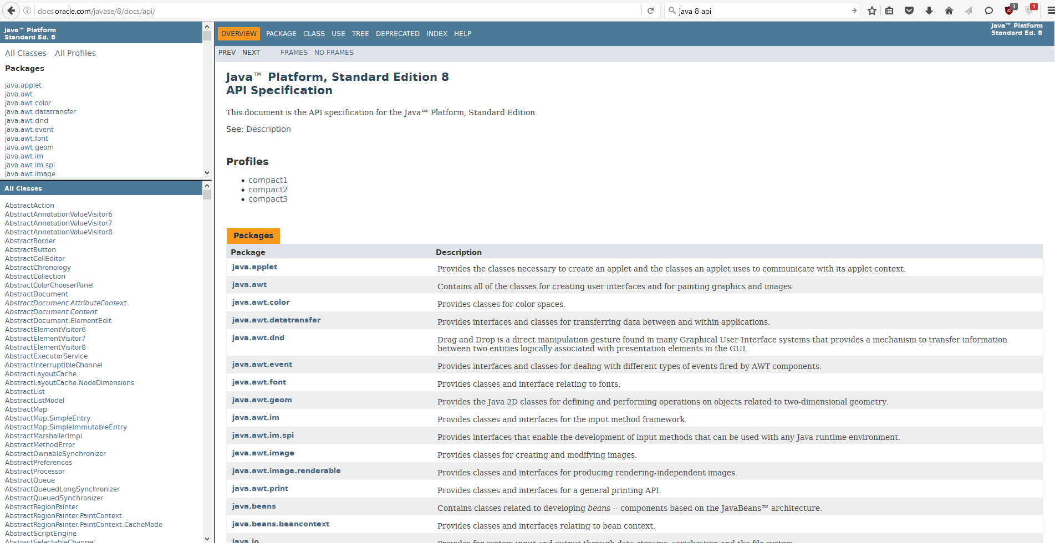
Application Programming Interface
The Java “dictionary”
http://docs.oracle.com/javase/8/docs/api/

Slide 5
What Can I Do with It?
Look up relevant classes (e.g. String) for their relevant functions/methods.

Slide 6
An Example
What is the 4th character of "Nathan" and how do I get it?
Check the API

Slide 7
Code Example
public class Name
{
public static void main(String[] args)
{
String name = "Nathan";
System.out.println(name.charAt(4));
}//end method main
}//end class Name
There’s one slight issue

Slide 8
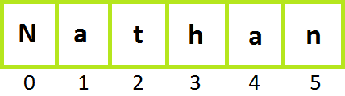
Counting in Java
The first character in the series is at the 0th index

Slide 9
Code Example
public class Name
{
public static void main(String[] args)
{
String name = "Nathan";
System.out.println(name.charAt(3));
}//end method main
}//end class Name
The 4th character is at the 3rd index

Slide 10
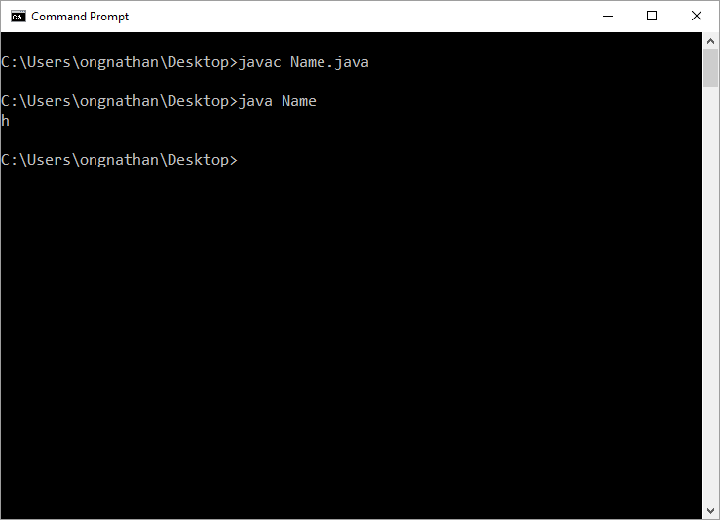
Code Example

Slide 11
Another Example
How do I get "urge" from "hamburger"?
(It’s a substring)
Check the API

Slide 12
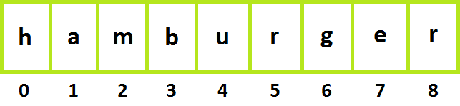
Re-Counting in Java
The first character in the substring is at the 4th index

Slide 13
Re-Counting in Java
The last character in the substring is at the 7th index

Slide 14
Another Example
public class DriveThru
{
public static void main(String[] args)
{
String fastFood = "hamburger";
System.out.println(fastFood.substring(4,7));
}//end method main
}//end class DriveThru
There’s one slight issue
“The substring begins at the specified beginIndex and extends to the character at index endIndex – 1”
Where can I find this information?

Slide 15
Re-Counting in Java
The last character in the substring is at the 7th index → endIndex – 1 = 7

Slide 16
Another Example
public class DriveThru
{
public static void main(String[] args)
{
String fastFood = "hamburger";
System.out.println(fastFood.substring(4,8));
}//end method main
}//end class DriveThru
.

Slide 17
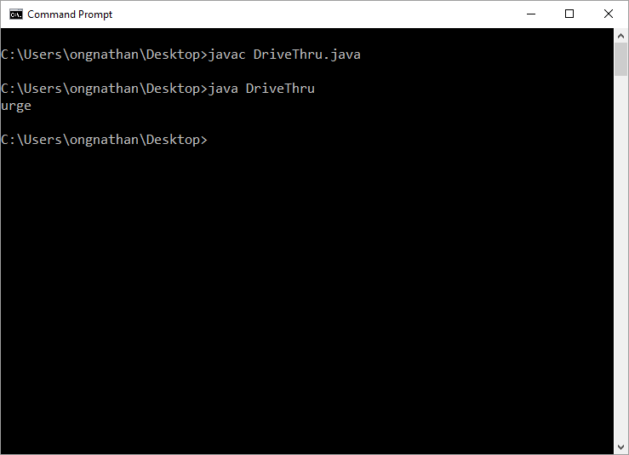
Another Example

Slide 18
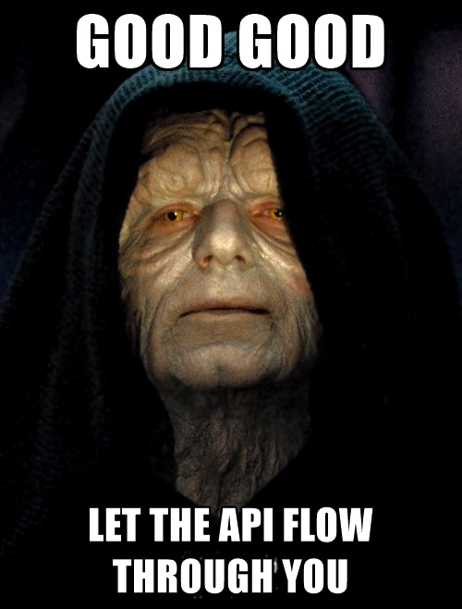
You must learn to embrace the API

Slide 19
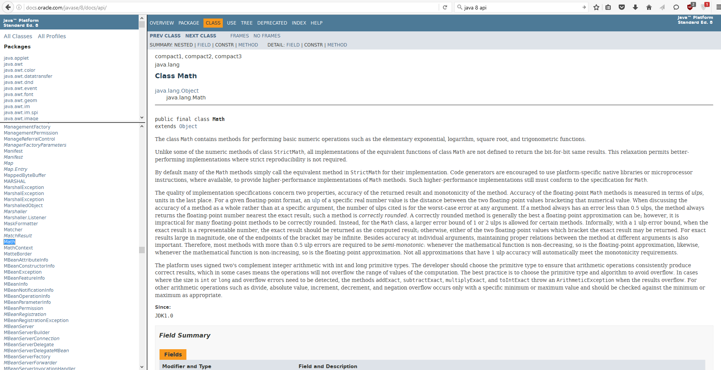
Math Class

Slide 20
Remember from before
The caret (^) does NOT indicate exponentiation
In other words, in Java, 2^3 does not equal 8
There is another way to do exponentiation; maybe it is in the Math class?

Slide 21
Math Example
public class MorePower
{
public static void main(String[] args)
{
double base = 2.0;
double exponent = 3.0;
System.out.println(Math.pow(base,exponent));
}//end method main
}//end class MorePower
.

Slide 22

Math Example

Slide 23
When to Use the Variable/Class Name
Does the “Modifier and Type” column of the method say “static”?
  Yes: Use Class name (typically uppercase first letter)
  No: Use variable name (typically lowercase first letter)

